Slide 1
Steganography Detection and Analysis in Forensics
BY: Harsh Raj
219302137

Slide 2
What is Steganography?
Steganography is the technique of concealing secret information within ordinary files like images, audio, video, or text so that the hidden message goes unnoticed. It appears as regular content, making it difficult to detect.

Slide 3
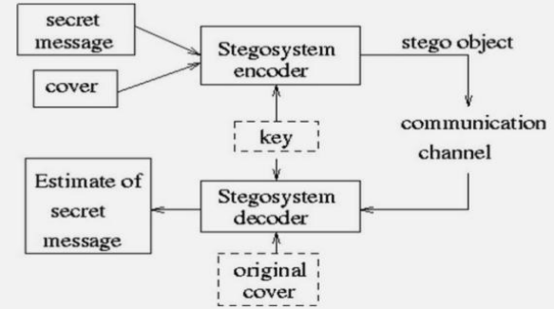
Basic Steganographic Model
Secret Message: The secret message is information that needs to be hidden in some suitable digital media.
Cover: It carries messages such as image, audio, video, or other digital media.
Stego Object: it is the file that contains hidden data after the process of steganography. It closely resembles the original Cover Object, ensuring the hidden data remains undetectable.

Slide 4
Importance in Forensic Investigations
Uncovering Hidden Evidence: Forensic experts often use steganalysis techniques to detect hidden data in digital evidence during criminal investigations.
Tracking Illicit Activities: Criminals and hackers use steganography to exchange information without detection, especially in cybercrime or terrorism cases.
Preserving Chain of Evidence: Understanding steganography helps investigators retrieve hidden data while maintaining its integrity for use in court.

Slide 5
Types of Steganography
Image Steganography: Hiding the data by taking the cover object as the image is known as image steganography.
Text Steganography: it is hiding information inside the text files. It involves things like changing the format of existing text, changing words within a text, generating random character sequences
Audio Steganography: the secret message is embedded into an audio signal which alters the binary sequence of the corresponding audio file.
Network Steganography: Embedding information within network protocols or data packets transmitted over a network.
Video Steganography: one can hide data in digital video format.

Slide 6
Challenges in Detection
Encryption and Minimal Alteration
Challenge:
Steganography often combines with encryption, making hidden data further concealed.
The minimal alterations in host files (e.g., slight changes in pixel values or audio signals) make detecting hidden data extremely difficult.
Example:
Encrypted content in an image is nearly undifferentiable from noise or natural variations.

Slide 7
Challenges in Detection
Legal and Ethical Concerns
Challenge:
Detecting steganography may involve violating privacy or intellectual property rights, raising ethical and legal issues. Each technique requires specific detection methods and tools.
Legitimate uses of steganography (e.g., secure communication for whistleblowers) complicate its blanket classification as suspicious activity.
Example:
Accessing private files to detect hidden content could lead to lawsuits or ethical disputes.

Slide 8
Detection Methods
Visual Analysis
Involves manually inspecting media (e.g., images, videos) for anomalies or irregularities.
It is effective for simple techniques like poorly implemented LSB steganography.
Statistical and Pattern Recognition Methods
Uses mathematical and statistical models like Chi-Square Test, Histogram Analysis to identify patterns indicative of hidden data.
Machine Learning in Steganalysis
Leverages trained models to detect steganographic content by analyzing patterns that humans or traditional tools might miss.
CNN-based models for image steganalysis.

Slide 9
CONCLUSION
Steganography detection plays a pivotal role in digital forensics by enabling investigators to uncover hidden information embedded within digital media. This strengthens forensic capabilities in combating covert communication and digital threats. This is essential for:
Uncovering Hidden Evidence
Tracking Cybercrime and Terrorism
Maintaining Evidence Integrity
Challenging Illicit Methods

Slide 10
Thank You

